Slide 2
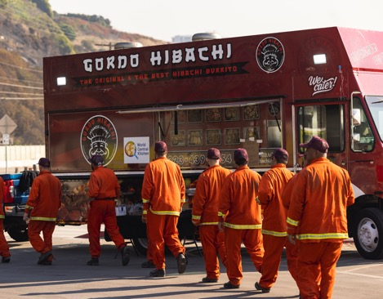
Feeding People Through Disasters
NASA satellite data helps build maps for first responders, including chefs and other food support
World Central Kitchen: Washington, DC
Washington-based World Central Kitchen uses data from satellites in low Earth orbit to build maps supporting staff and volunteers distributing food and water in disaster areas. The nonprofit gets the data through NASA’s Disasters Response Coordination System, managed by Goddard Space Flight Center.

Slide 3
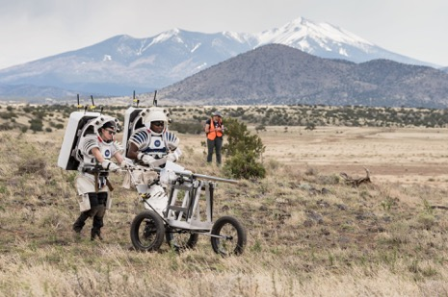
Extraterrestrial Medical Diagnostics
Miniature laboratory technology tested by NASA returns fast blood test results
1Drop Diagnostics US: Boston, MA
A portable device made by Boston-based 1Drop Diagnostics US can test a single drop of blood for numerous medical conditions. Glenn Research Center prepared the technology for testing on the International Space Station, and it now supports medical research on Earth.

Slide 4
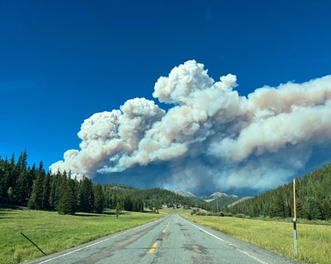
Filtering Out Risk
Environmental stewardship for businesses begins with NASA data
World Wildlife Fund: Washington, DC
The World Wildlife Fund, whose U.S. headquarters is in Washington, uses Earth-observation data managed by Goddard Space Flight Center in its Risk Filter Suite. The platform informs businesses’ understanding of the natural resources they require and tracks risks to those resources.

Slide 5
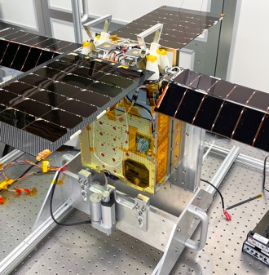
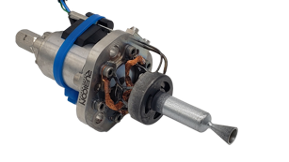
Making Future Satellite Fuel Today
A non-toxic propellant is fueling safer propulsion systems thanks to NASA’s efforts
Rubicon Space Systems: Huntsville, AL
With the help of a former Marshall Space Flight Center employee, Rubicon Space created a new in-space propulsion system for satellites. The Huntsville, Alabama company employs a non-toxic fuel that’s safer for ground crews during fueling and performs better than traditional fuels.

Slide 6
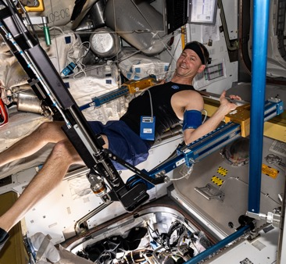
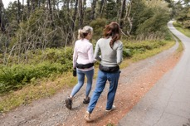
Boosting Bone Health
Using NASA data, new technology promotes strong bones
Osteoboost Health: Redwood City, CA
Because astronauts can lose bone density on long-duration missions, Johnson Space Center conducts research on bone loss. Data provided by NASA-funded research helped Osteoboost Health of Redwood City, California, develop Osteoboost, a new FDA-approved device that treats early-stage bone loss.

Slide 7
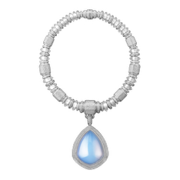
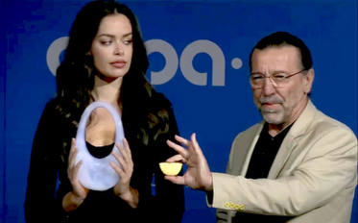
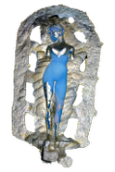
Aerogel Art Attracts Attention
Comet-catching NASA technology enables exotic works of art
Ioannis Michalous: Limassol, Cyprus
Lessons learned during visits to an aerogel lab at the Jet Propulsion Laboratory helped Ioannis Michaloudis of Limassol, Cyprus, build a career as an aerogel artist. The material is difficult to work with but has many unusual and striking qualities.

Slide 8
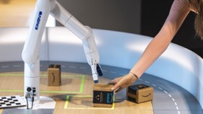
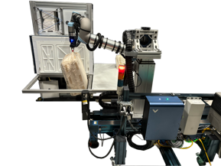
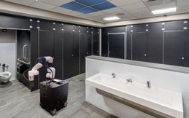
NASA ‘Arms’ Astronauts, Industry with Robotic Intelligence
To free up astronauts, NASA tackles complexity of controlling robotic arms
PickNik: Boulder, CO
With the help of SBIR funding from Johnson Space Center, PickNik Robotics of Boulder, Colorado, developed and refined its MoveIt Pro robotic automation software and then worked with roboticists in Johnson’s Integrated Mobile Evaluation Testbed for Robotics Operations facility to prove the software’s functionality.

Slide 9
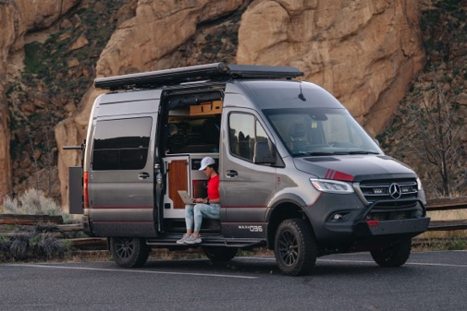

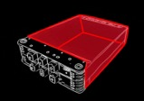
Keeping Cool, Containing Flame
A new fire-retardant insulation enhances battery safety and more
Solarcore: Portland, OR
Funding from the Astronaut Scholarship Foundation helped launch the Oros outdoor clothing line that incorporates aerogel insulation. Lessons about aerogel created by Kennedy Space Center led to a new non-toxic, fire-retardant formula. Now Portland-Oregon based Solarcore has spun off from Oros to offer industry an ultra-thin insulation.

Slide 10
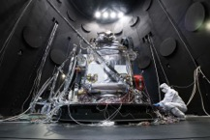
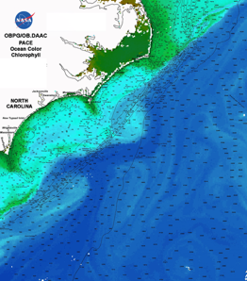
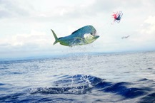
Forecasting Fish from Space
For four decades, company has used satellite data to guide sportfishing
Roffer’s Ocean Fishing Forecasting Service (ROFFS): West Melbourne, FL
Roffer’s Ocean Fishing Forecasting Service, or ROFFS, of West Melbourne, Florida, uses data about ocean color and surface temperature, gathered by Earth-observation satellites and made available through Goddard Space Flight Center, to forecast the presence of big game fish for anglers.

Slide 11
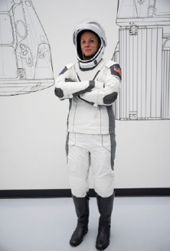
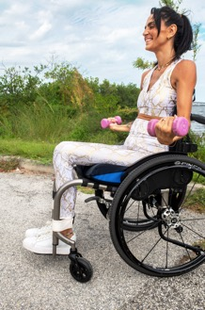
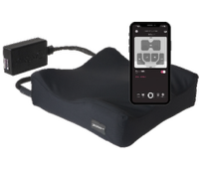
A Better Seat for the Seated
Experience meeting NASA requirements helped design innovative
wheelchair cushion
Kalogon: Melbourne, FL
Kalogon was founded in Melbourne, Florida, by a former NASA contractor, who used experience working on the Commercial Crew Program based at Kennedy Space Center to design a wheelchair seat that helps prevent blood clots and deep vein thrombosis.

Slide 12
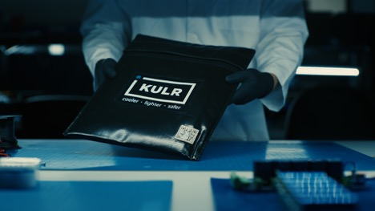
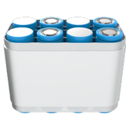
For Battery Safety, KULR Heads Prevail
Company’s work with NASA improves lithium-ion battery manufacturing,
testing, packaging
KULR Technology Group: Webster, TX
KULR Technology Group, based in Webster, Texas, has leveraged technology licensed from Johnson Space Center, earlier work done for the agency, and the long NASA experience of its chief technology officer to develop products and testing services around lithium-ion battery safety.

Slide 13
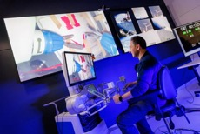
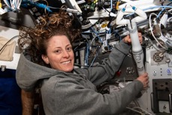
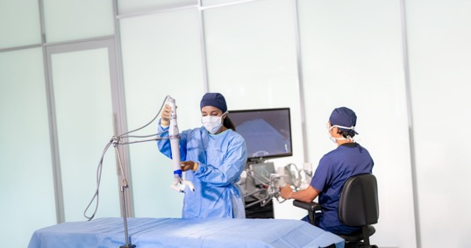
Robots in the Operating Room
Small, minimally invasive, portable surgical robot developed with NASA support
Virtual Incision: Lincoln, NE
Virtual Incision of Lincoln, Nebraska, used funding from Johnson Space Center to develop a mini surgical robot that’s now authorized for colectomies. A version of the device designed for space successfully performed a demonstration on the International Space Station.
.

Slide 14
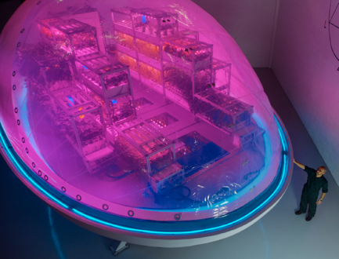
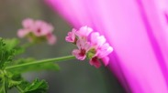
Lunar Gardening Device Grows Health, Beauty Ingredients
Cosmetics industry leaders turn to planting system designed for space
Interstellar Lab: Merritt Island, FL
Barbara Belvisi founded Interstellar Lab, whose U.S. office is in Merritt Island, Florida, while consulting with experts at Ames Research Center. Her early designs became the Earth-based Biopod for precision agriculture, before going on to inform NuCLEUS, in-space farming tech that won NASA’s Deep Space Food Challenge.

Slide 15
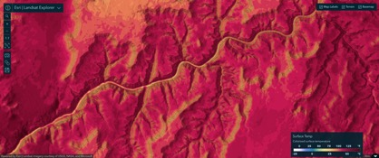
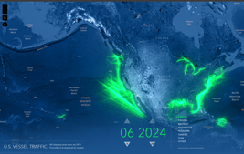
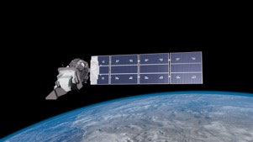
Mapping a World of Data
Easy access to NASA data helps businesses and individuals
Esri: Redlands, CA
Esri’s Living Atlas offers a bird’s-eye view of Earth by combining free Earth-observation data from Goddard Space Flight Center with other resources. Continual updates by the Redlands, California company feed into apps that monitor everything from air quality and wildfires to hurricanes and shipping traffic.

Slide 16
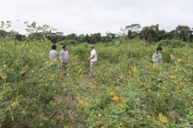
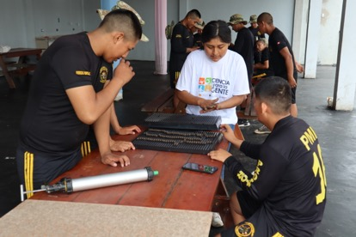
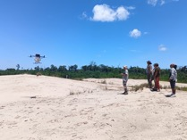
Drone Company Makes It Rain Forests
Flying Forests cofounder builds on NASA science and technology experience
Flying Forests: Reno, NV
At Ames Research Center, Lauren Fletcher learned about building hardware around plant and animal biology. Later, he applied those lessons to create seedball-launching drones that are helping to reforest the planet, including at his latest company, Flying Forests of Reno, Nevada.

Slide 17
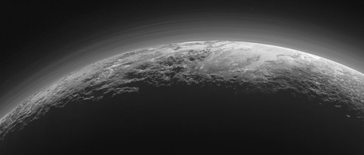
From Pluto to Farms and Pharmaceuticals
Water-finding filter for dwarf planet helps out on Earth
VIAVI Solutions: Scottsdale, AZ
A filter technology used in numerous NASA missions, including Goddard Space Flight Center’s Pluto-exploring New Horizons, is at the heart of Chandler, Arizona-based VIAVI Solutions’ MicroNIR, a handheld spectrometer that analyzes materials and ingredients on Earth.

Slide 18
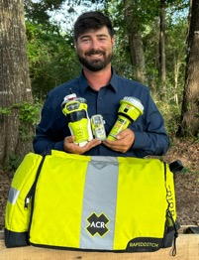
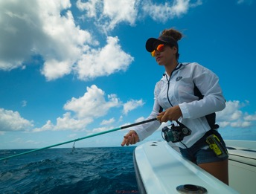
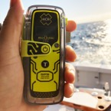
Saving Lives at Sea and on Land
Emergency rescue thanks to satellite-based locator beacon
ACR Electronics: Fort Lauderdale, FL
Satellites carrying Search and Rescue Satellite-Aided Tracking technology act as the link between emergency beacons and worldwide search and rescue teams. ACR Electronics of Fort Lauderdale, Florida, manufactures locator beacons according to specifications developed in part by Goddard Space Flight Center, contributing to more than 50,000 rescues.

Slide 19

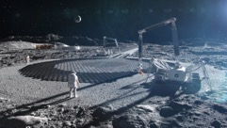

Mission: Home
A Texas community is 3D printed like a Martian habitat
ICON Technology: Austin, TX
After 3D printing a model Martian habitat at Johnson Space Center, ICON built a 100-home community outside of Austin, Texas, where the company is headquartered.

Slide 20
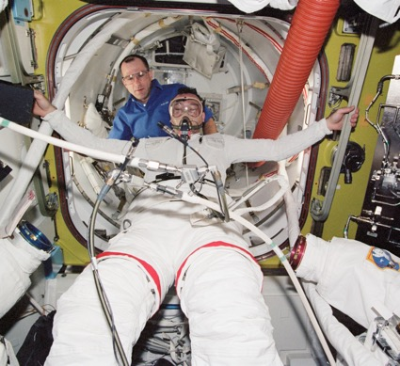
NASA Invention Goes Straight to the Heart
Pulmonary artery pressure sensor helps avert heart failure, keep patients out of hospital
Endotronix: Naperville, IL
Two engineers at Glenn Research Center developed a tiny, implantable transmitter and handheld reader. Endotronix of Naperville, Illinois, now part of Edwards Lifesciences, licensed the patent and used it to develop a heart monitor that warns heart failure patients of an impending crisis.

Slide 21
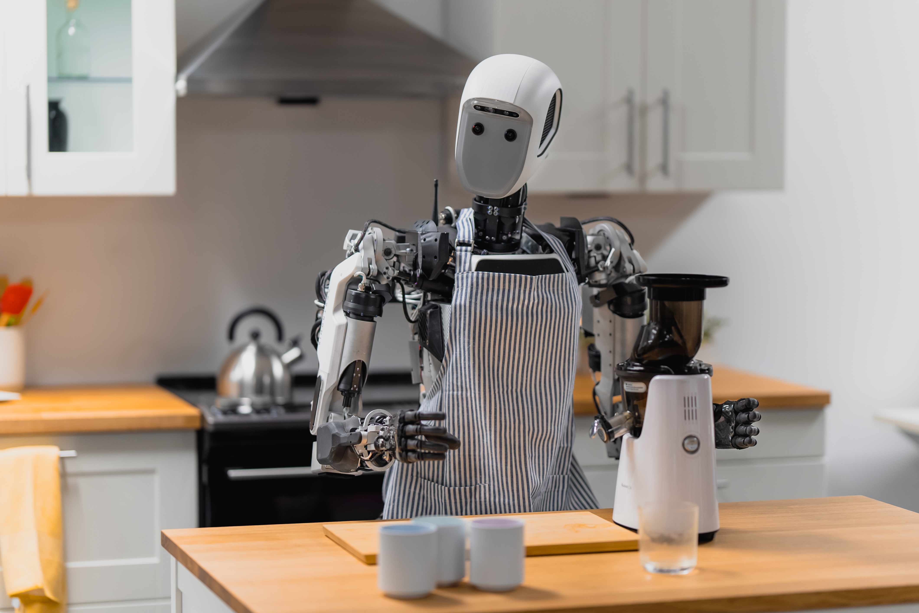
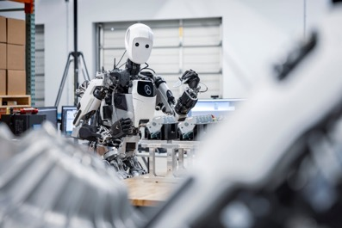
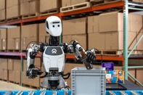
Humanoid Robots Assist Assembly Lines
Apollo robots work in environments designed for people — on Earth and in space
Apptronik: Austin, TX
A humanoid robot from Austin, Texas-based Apptronik is the result of numerous collaborations with Johnson Space Center, including SBIR contracts. The Apollo robot is currently working in factories on Earth.

Slide 22
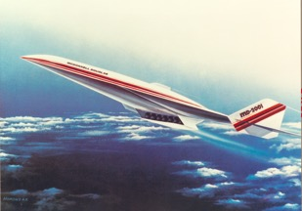
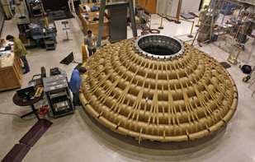
Beat the ‘Heet’ at 400,000 Feet
NASA funding helps high-tech insulation take flight
Heetshield: Flagstaff, AZ
Langley Research Center has funded multiple SBIR contracts with Flagstaff, Arizona-based Miller Scientific, doing business as Heetshield, which then developed insulation for industrial purposes and innovated new methods of manufacturing insulation for commercial aerospace.

Slide 23
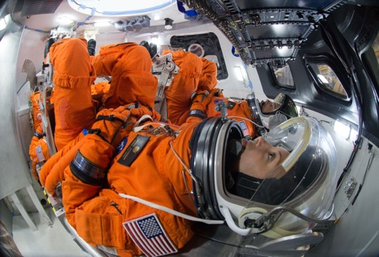
Simulations That Are Positively Radiant
Radiation simulation software helps keep astronauts and patients safe
Tech-X: Boulder, Colorado
To develop radiation sensors for deep space missions, Johnson Space Center provided SBIR funding to Tech-X Corporation in Boulder, Colorado, to design software that reliably simulates how radiation travels, which is useful for commercial space, industrial manufacturing and medical devices.

Slide 24
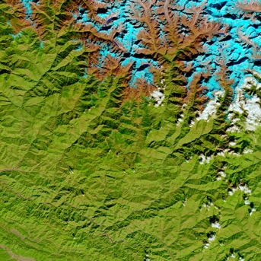
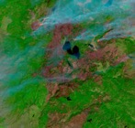
Planet in a Program
Joint effort yields open-source artificial intelligence foundation models of the entire planet
IBM: Armonk, NY
Engineers at Ames Research Center and IBM, headquartered in Armonk, New York, worked together to build artificially intelligent foundation models of the planet based on Earth-imaging and weather data, creating living digital models of the globe that can be trained for countless applications.

Slide 25
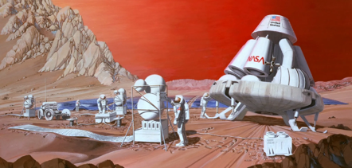
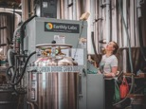

Machines from Mars Make Beer Bubbly
Carbon-capture technology repurposed for breweries spreads and finds new applications
Earthly Labs: Austin, TX
Earthly Labs of Austin, Texas, now part of Chart Industries, built small-scale carbon-capture technology based on a license from Pioneer Energy. Pioneer had developed the technology based on work the company’s founder did for Johnson Space Center to enable the separation and combination of elements on Mars.

Slide 26



Lunar Lattices and Their Earthly Impact
Novel 3D printing process enables lightweight structures in space and on Earth
Branch Technology: Chattanooga, TN
Winning NASA’s 3D Printed Habitat Challenge and outfitting a model lunar habitat for Marshall Space Flight Center have helped Chattanooga, Tennessee-based Branch Technology evolve its signature Freeform 3D Printing technique, which it uses to manufacture custom terrestrial products, including wall panels and cladding.

Slide 27

Technique for Manipulating Satellite Photos Now Reveals Ancient Images
Algorithm NASA first applied to satellite imagery is used to peer into antiquity
Jon Harman: Pacifica, CA
Rock art enthusiast Jon Harman of Pacifica, California, created the Dstretch software plug-in to enhance digital imagery, based on the decorrelation stretch technique invented at the Jet Propulsion Laboratory. Dstretch is now widely used to make ancient, faded markings visible in photographs, among other applications.

Slide 28


Teaching an Old Metal New Tricks
NASA data enables industry’s continued use of shape-changing memory alloy
Metalwerks: Aliquippa, PA
In the 1960s, Langley Research Center oversaw a comprehensive investigation of the shape memory alloy nitinol, research that was foundational to nitonol products from Metalwerks, including a new formulation. The Aliquippa, Pennsylvania-based company supplies the medical field and high-tech manufacturing industries with the shape memory alloy.

Slide 29



3D Printable Alloy Can Take the Heat
NASA-developed metallic alloy fills big materials gap for printed parts
Elementum 3D: Erie, CO
GRX-810, a new alloy developed by Glenn Research Center, will make lightweight, durable metal parts needed for space travel. Under a co-exclusive license for the patented alloy, Elementum 3D of Erie, Colorado, is making it available for commercial space, aviation, and other industries on Earth.

Slide 30

Living Off Our Moon
NASA lunar data finds resources to inform technology, mission planning
Lunar Station: Cambridge, MA
Decades of data that Johnson Space Center has used to identify the possible location of water ice and minerals on the Moon also powers Lunar Station’s analysis of in-situ resources to support mission planning. The Cambridge, Massachusetts-based company can also analyze radiation risk for landers and other surface resources.

Slide 31


The Impact of Space Junk
Software from NASA gives industry a space debris-mitigation resource
Kepler Communications: Toronto, Canada
A Debris Assessment Software license helps Toronto-based Kepler Communications test a virtual copy of its satellites, verifying the effectiveness of the planned deorbit scenario required by federal agencies worldwide. NASA’s Johnson Space Center continually updates the program to protect property and people.

Slide 32

New Insulation Can Benefit Many Industries
Enhancements to a classic spinoff can benefit hydrogen energy, refrigeration, more
Quest Thermal Group: Arvada, CO With SBIR funding from Glenn Research Center and other NASA field centers, Quest Thermal Group of Arvada, Colorado, developed a more uniform, effective, structurally sound take on traditional multilayer insulation and refined it into several specialized versions for different applications. These insulators will also be useful on Earth.

Slide 33



Knowledge Is Battery Power
Smart battery management software traces lineage to work with NASA
Electra Vehicles: Boston, MA
After working with Goddard Space Flight Center on SBIR grants, the founder of Electra Vehicles transferred the knowledge he gained and technology he developed to the field of electric vehicle battery management systems.

Slide 34


Handbag Made from Basic NASA Research
Space agency interest in organisms and protein result in a fungi faux leather
Hydefy: Chicago, IL
The manufacturing process for a fungi-based leather alternative from Hydefy, a brand from Nature’s Fynd in Chicago, benefited from SBIR funding from Ames Research Center.

Slide 35



NASA-Derived Textiles Go on Tour
Temperature-controlling fabric helps athlete cyclists perform
Ekoï: Fréjus, France
To improve temperature-regulating materials for spacesuits, Johnson Space Center provided SBIR funding that resulted in a phase-change material commercialized under the name Outlast. Today, Ekoï cycling gear is made with Outlast to help athletes maintain performance and keep cyclists comfortable.

Slide 36

Old-School Software Enables New Missions
Trajectory software NASA commissioned decades ago has grown into a tool for all
Ansys: Canonsburg, PA
Trajectory design and visualization software Goddard Space Flight Center funded in the late 1980s has evolved into Astrogator, part of the Systems Tool Kit from Canonsburg, Pennsylvania-based Ansys. The software has been used in numerous NASA and commercial missions

Slide 37


A Planetary Sensor’s Earthly Applications
NASA-funded technology detects fires, shale, and more
CoolCAD Electronics: Greenbelt, MD
Technology supported by NASA for identifying planetary conditions is used on Earth by frackers and others. The photodiodes from Greenbelt, Maryland-based CoolCAD Electronics Inc. have received Goddard Space Flight Center funding, including through the SBIR program.

Slide 38


Softer Moon Landings for Companies
NASA helps private sector soar with better navigation technology
Psionic: Hampton, VA
Landing technology developed at Langley Research Center is now available from Psionic Inc. of Hampton, Virginia, which holds the license and has been improving the Doppler lidar device.

Slide 39


Spotting Invisible Gas Leaks
Processed satellite imagery helps companies identify and contain methane losses
Momentick: Tel Aviv, Israel
Momentick of Tel Aviv, Israel, applies proprietary image-processing algorithms to data from several Earth-imaging satellites, especially the Landsat missions, which Goddard Space Flight Center manages for NASA, to spot otherwise invisible plumes of methane escaping from oil and gas operations.

Slide 40

Search for Life Helps the Search for Oil
NASA’s search for life signs on Mars is a boon for oil and gas production on Earth
Impossible Sensing: Calgary, Canada
To bolster development of sensors for exploring alien worlds, NASA provided SBIR funding to Impossible Sensing of Calgary, Canada, to improve spectroscopic sensors, which are now used to help oil companies explore deposits and increase yields.

Slide 41


Greens Grow in Circles
NASA-funded research inspires home indoor farming tech
Anu: Evansville, IN
After working on research funded by Ames Research Center into growing plants indoors, the founders of Heliponix, doing business as Anu, used what they learned to develop a system to aeroponically grow fruits and veggies.

Slide 42

Probe Deeper with Better Space Receivers
Software-defined radios give adaptability to satellite operators
Argotec: Melbourne, FL
To build a better radio for deep space exploration missions, the Jet Propulsion Laboratory developed a small, configurable radio that’s just as capable as larger models. Today, Argotec, a Mativ brand based in Turin, Italy, with offices in Melbourne, Florida, has licensed the radio and offers it commercially.

Slide 43


Weaving Data Fabric with AI
Air taxis and drones navigate different zones with NASA-inspired system
Autonomy Association International: Mountain View, CA
Through a Space Act Agreement with NASA Ames Research Center, Autonomy Association International of Mountain View, California, developed an artificial intelligence platform that is used by industrial customers today and air taxis of the future.

Slide 44

Data Analysis Goes to the Dogs
Knowledge graphs originally designed for NASA help make unseen connections
Stardog Union: Arlington, VA
NASA Headquarters approached experts to develop an artificial intelligence system to find institutional knowledge at the agency. That company, Stardog Union of Arlington, Virginia, now sells a version of it for use in data analytics.

